Slide 1

CLOTHING WEBSHOP PROJECT
MADE BY: ISTVÁN FRIDRIK, BALÁZS KAPITOR

Slide 2
TEAM MEMBER TASKS
István Fridrik (frontend)
- creating and designing the website
Balázs Kapitor (backend)
- creating the database
- data processing, management

Slide 3

FRONTEND (NAVBAR PART)
It is on the top of all the webpages
Contains animations and a responsive design
This part was the first to be completed in the frontend
It has gone through many changes

Slide 4
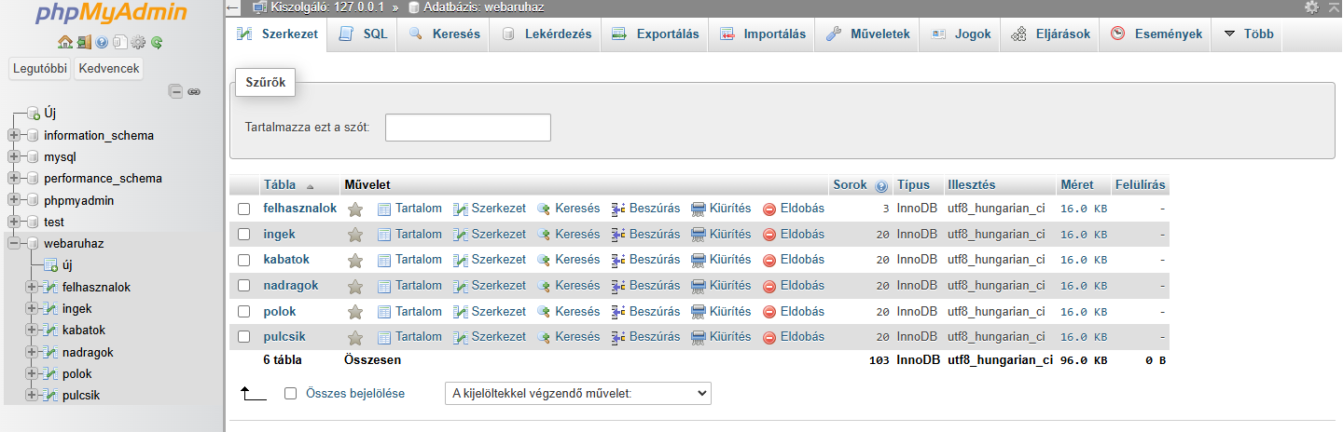
BACKEND (DATABASE PART)
The database was finished first in the backend
It contains 3 tables:
Users,
T-shirts,
Sweaters,
Trousers,
Jackets,
Shirts
When the user logs in, the input datas are sent to the users table

Slide 5
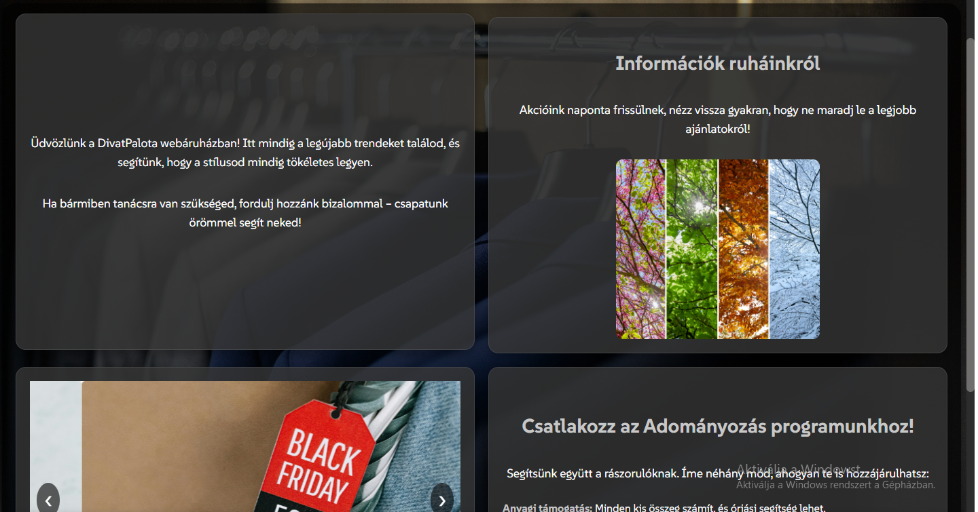
FRONTEND (HOME PAGE)
It is divided into 4 parts:
Welcome text
Informations about our clothes
Slideshow
Donation informations
It has a rounded design, and a custom font style

Slide 6
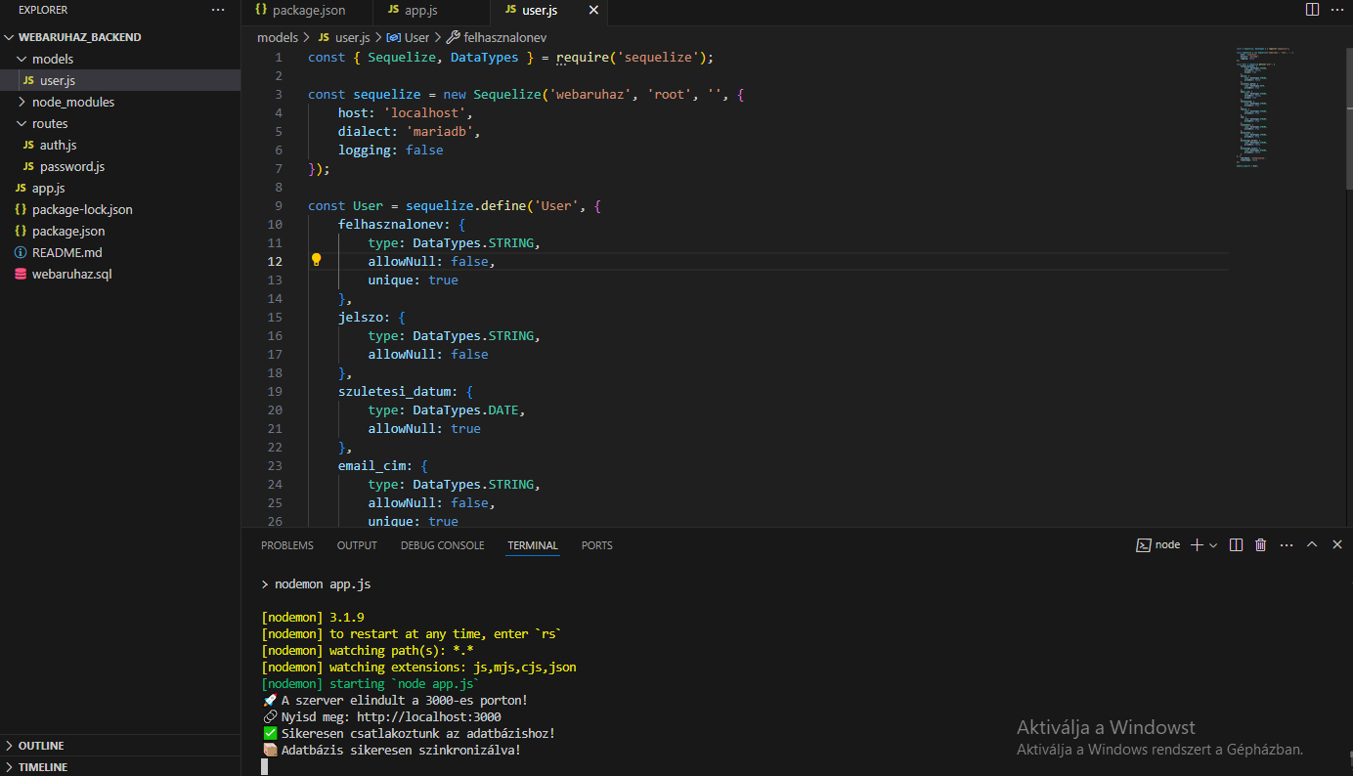
BACKEND (User data handling)
On the registration page, you need to type your data, including:
Name,
Username,
E-mail address
Password
The backend sends the data to the database and handles all errors

Slide 7
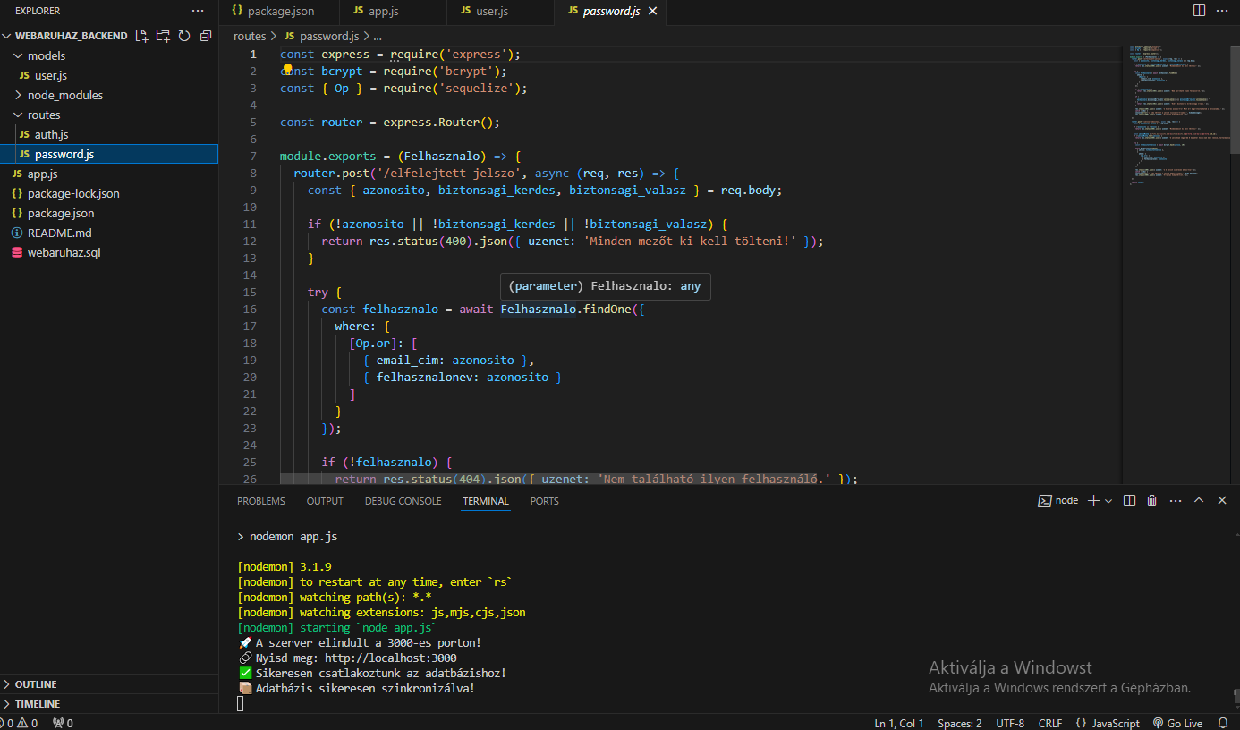
BACKEND (PASSWORD CHANGE)
It has 2 post methods:
Forgot-password
Password-change
When you enter the secure question and answer correctly, you can enter a new password
The backend overwrites the previous password

Slide 8
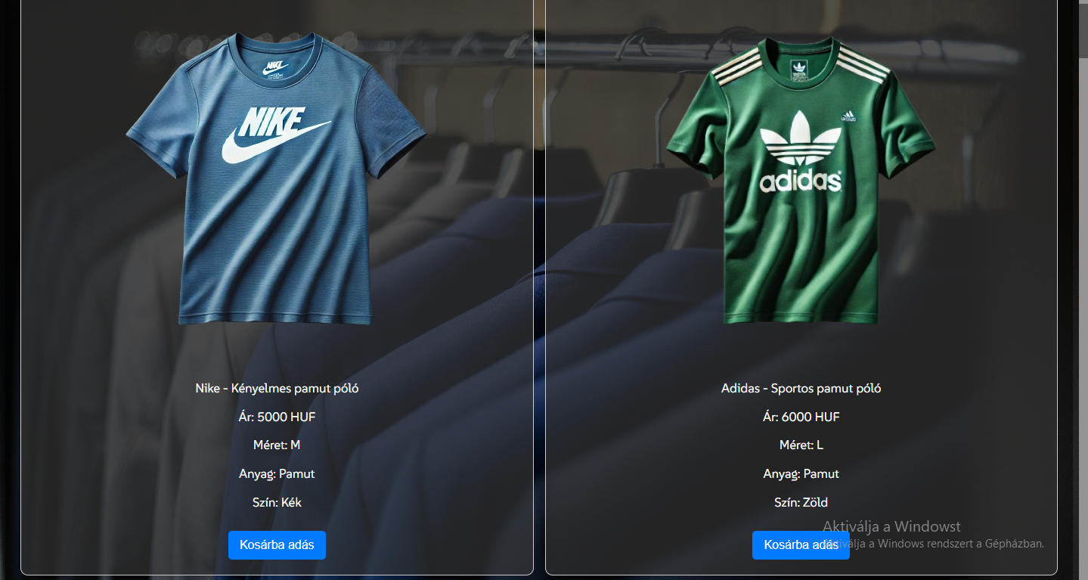
FRONTEND (CLOTHING SITE)
On this page, you can buy different T-shirts
You can put it into the cart after you log in
You can see some information:
Brand
Material
Price
Size
Color

